Slide 1
London CLO Summit 29 January 2025- Resources

Slide 2
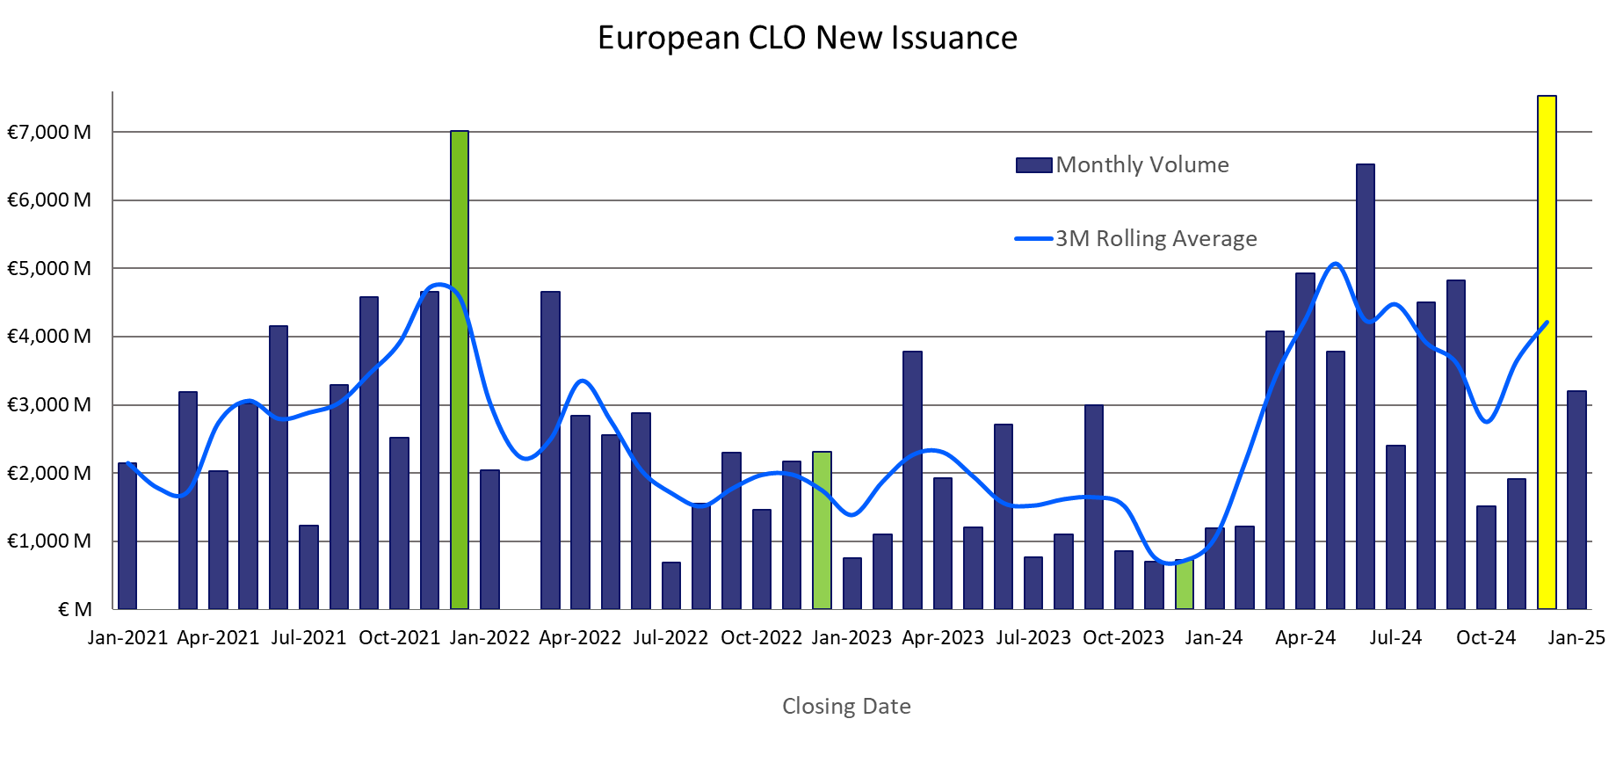
European CLOs Issuance Levels
Source: Moody’s Analytics

Slide 3
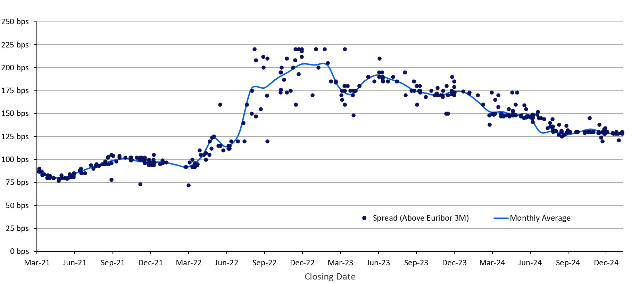
European Senior Tranche (Aaa/AAA rated) Spreads
Source: Moody’s Analytics

Slide 4
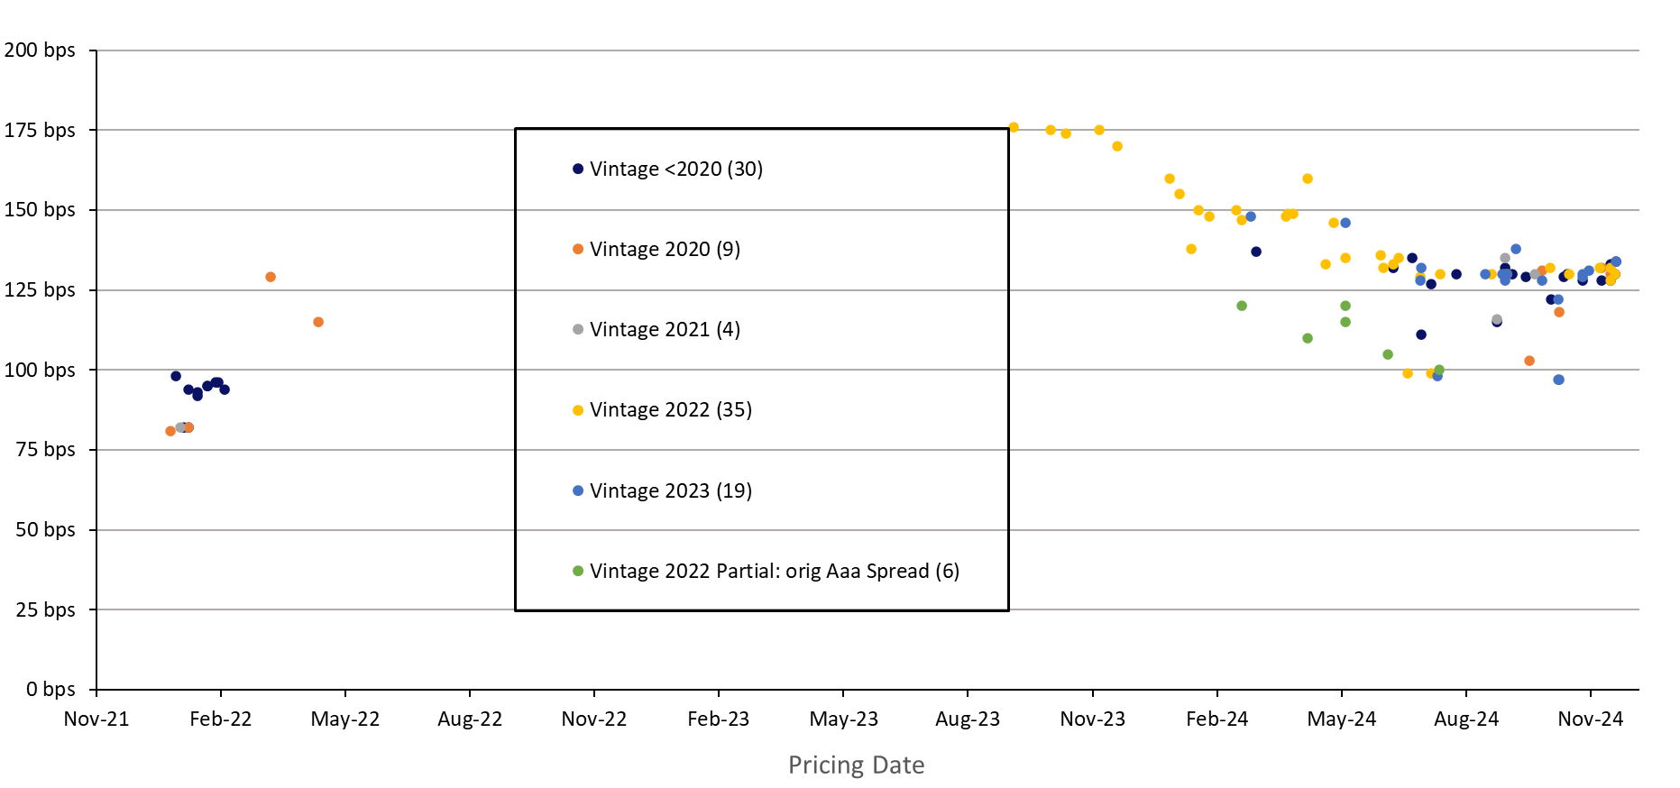
European Senior Spreads (Aaa/AAA rated) – Refis/Resets
Source: Moody’s Analytics

Slide 5
CLO Amortisation to be strong in 2025
Count of CLO transactions amortizing vs. reinvesting in Jan 25 & Jan 26
Source: Moody’s Ratings

Slide 6
European CLO Average Credit Quality Deteriorated
Weighted Average Portfolio Rating
Median Trustee Reported WARF Increased in Last 3M (Reinvesting +14, Amortizing +43)
Source: Moody’s Ratings as of November 2024.

Slide 7
Key Credit Metrics Will Deteriorate, but OC Cushions Will Grow
Number of CLOs > 6% exposure to Caa increased significantly
Exposure to Caa will increase as CLO portfolios amortize due to high collateral prepayment rates.
OC cushions will grow for senior tranches, but WARF will likely increase, especially among older vintages.
High prepayments leave CLOs more exposed to weaker issuers, with limited reinvestment ability for strong assets.
Share of CLOs with junior* OC cushions > 6% almost doubled
* Tranches rated Ba at closing
Source: Moody’s

Slide 8
CLO Early Amortization Rates Will Remain High
Junior Tranches Exposure to Weaker Residual Portfolios Increasing
Rating Actions Show Tranche Performance Bifurcation*
Median Caa Exposure Increased Particularly for Amortizing CLOs**
*Count of CLO tranche rating upgrades and downgrades in 2024 (as of 4-Nov- 2024)
Source: Moody’s Ratings
**Caa buckets for EMEA BSL CLOs we rate by reinvestment type
Source: Moody’s Ratings

Slide 9
Thank you
Firstname Lastname
Title/department
Contact information 1
Firstname Lastname
Title/department
Contact information 1
Firstname Lastname
Title/department
Contact information 1

